Slide 1
Survey
Products can be categorized in different ways on E-Commerce websites. Please rate the usefulness of the following organization options in helping you find the product you would like to buy. Please rate the followings from 1 to 5 (1=useless; 5=very helpful)
 | 1 | 2 | 3 | 4 | 5 | Don’t know
Shop by category |  |  |  | x
Shop by brand |  |  |  |  | x
Shop by price |  |  | x
Shop by recipient (e.g., products for children |  | x
Shop by alphabetical order |  |  | x
Shop by «occasion» |  |  | x
Shop by product on sale |  |  |  | x
Shop by top sellers |  |  |  |  |  | x

Slide 2
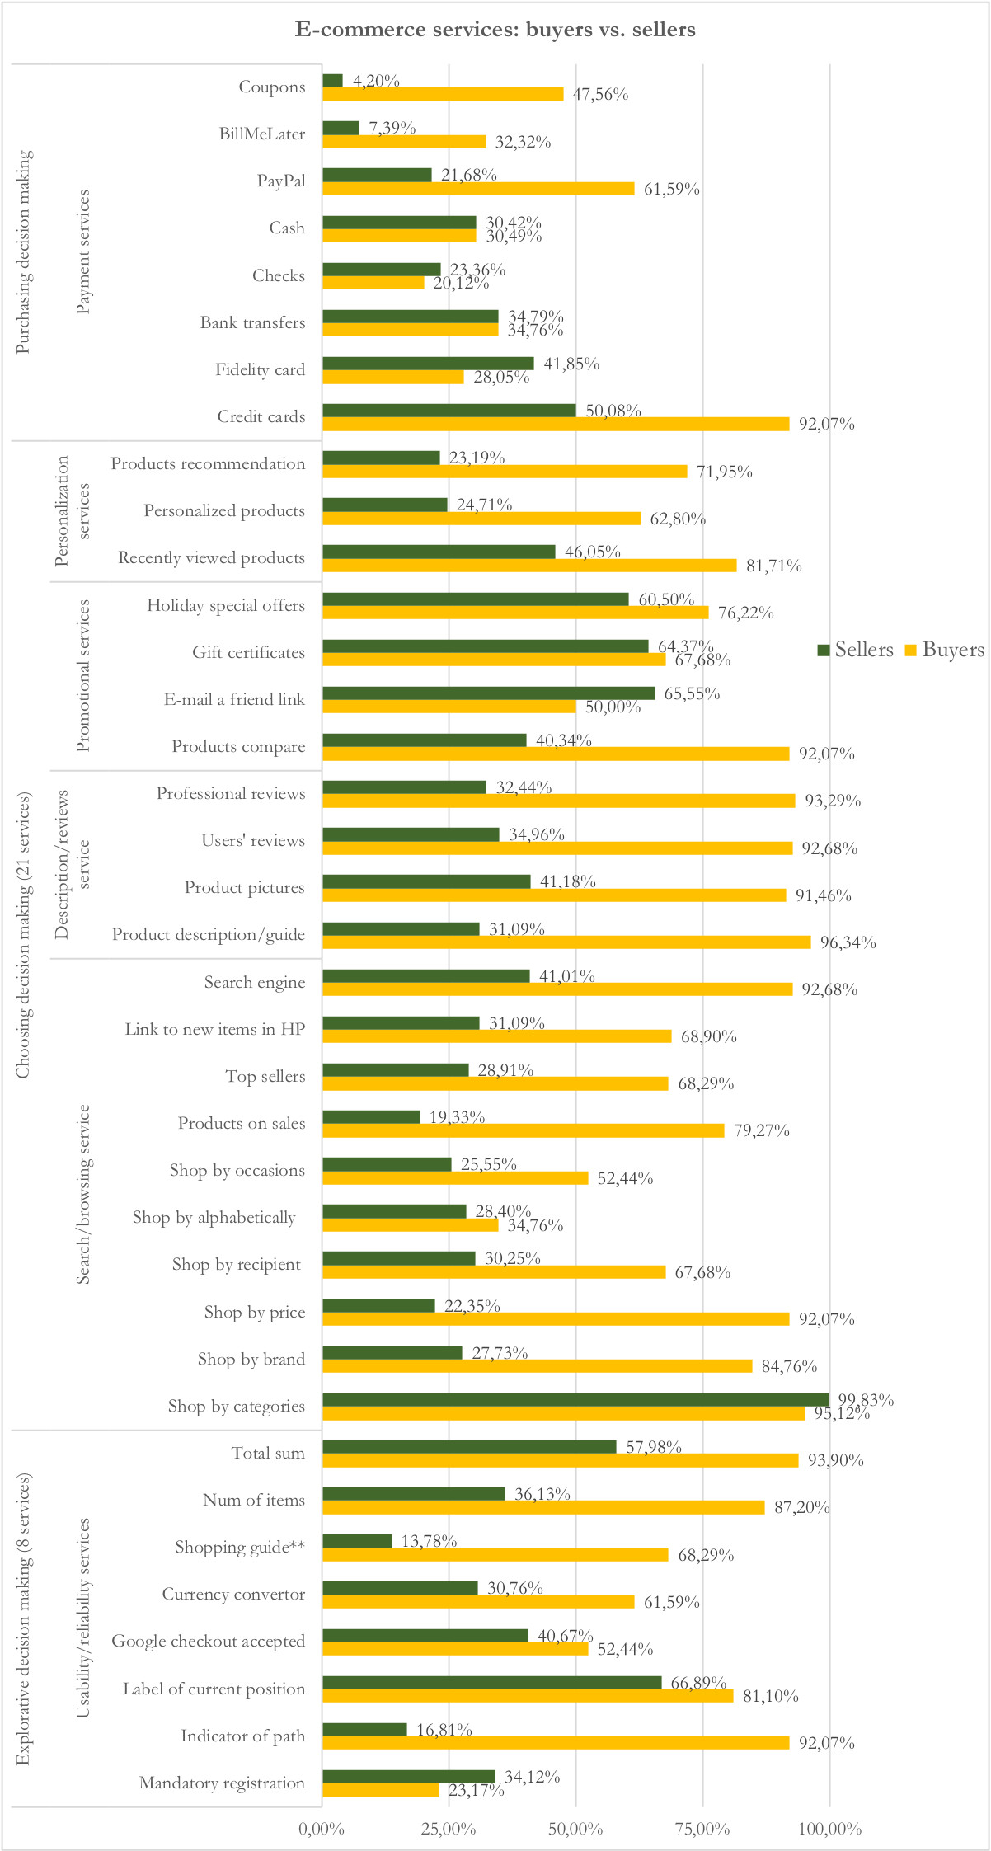
Sellers vs buyers

Slide 3
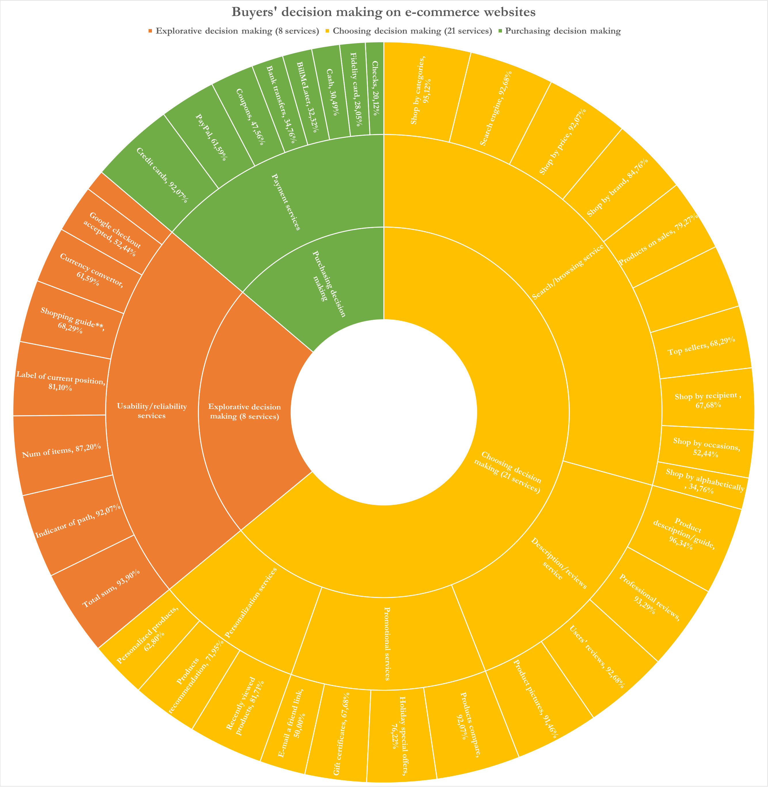
Qui

Slide 4
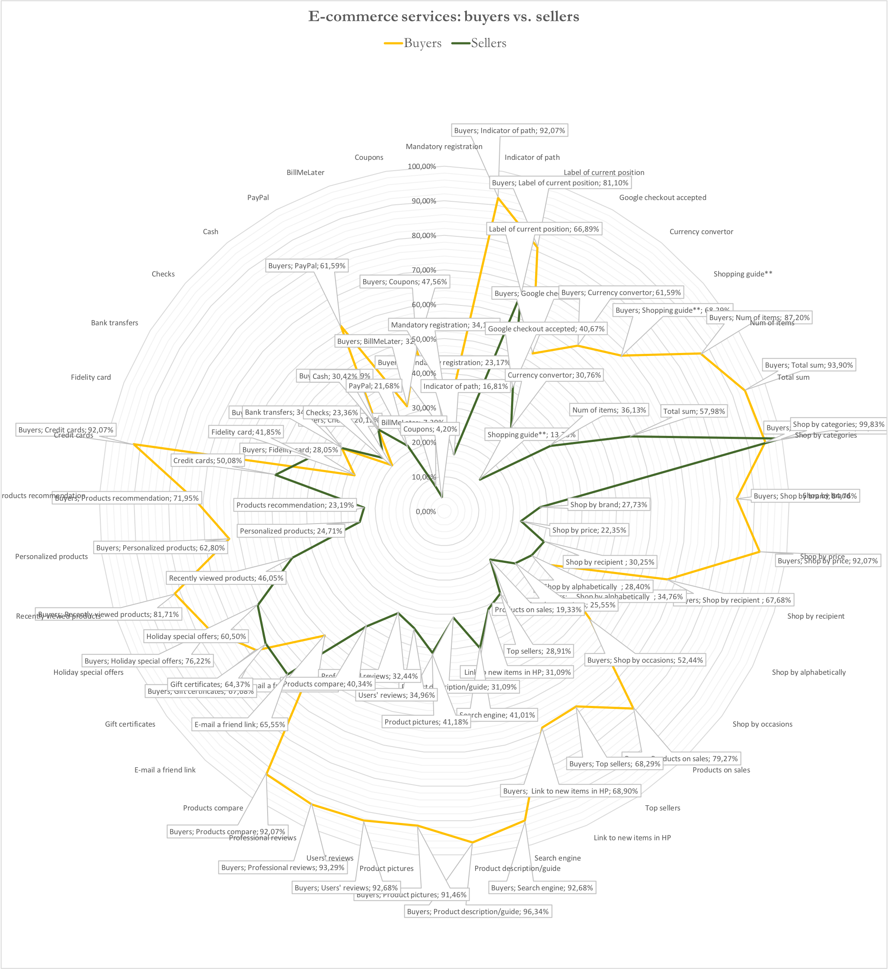
Realizzare un sito di e-commerce: quali servizi?

